Slide 1
Udacity self driving car engineer Nanodegree- Computer Vision
Document created by – Poluri Nikhil Koundinya
FROM LINEAR REGRESSION TO FEEDFORWARD NEURAL NETWORKS

Slide 2
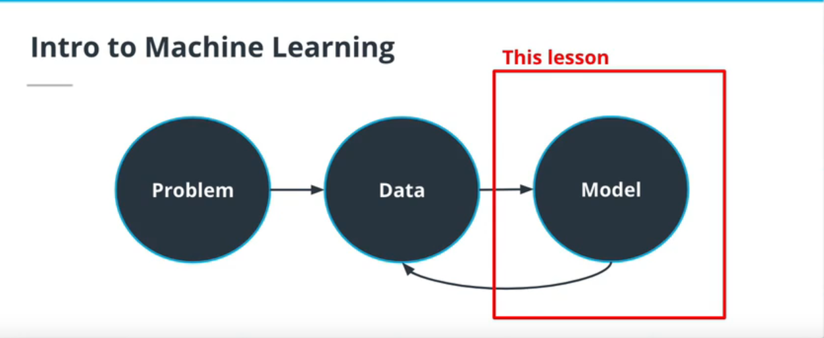
In this course, we focus on the prediction task, which consists of predicting an outcome using a set of observations. In particular, we will focus on the following:
Regression: predict a quantity (eg, distance, time) and understand the relation between two variables.
Classification: assign a discrete class (eg, traffic sign) to an input.
This lesson will be organized as follow:
Linear regression
Logistic regression
Optimization with gradient descent
Feed forward neural networks
Backpropagation
Image classification with a neural network

Slide 3
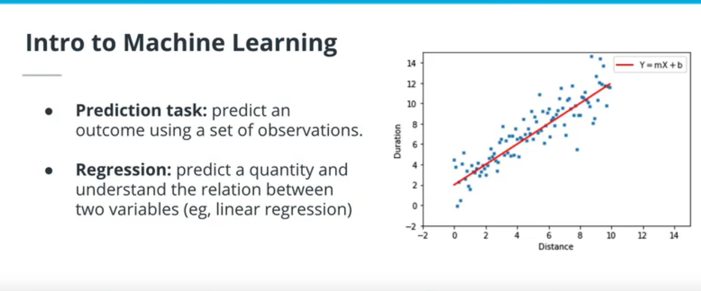
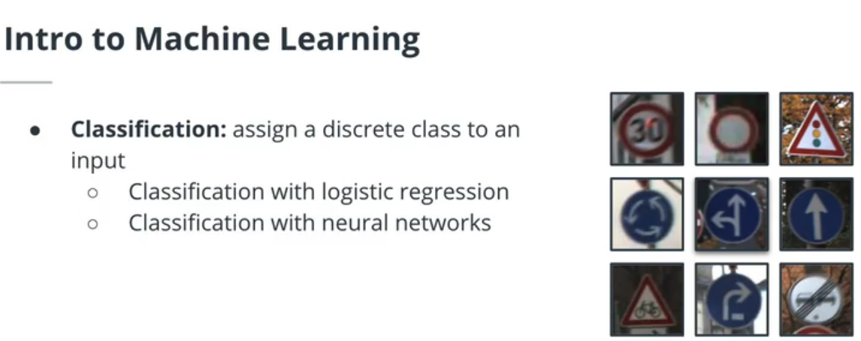

Slide 4
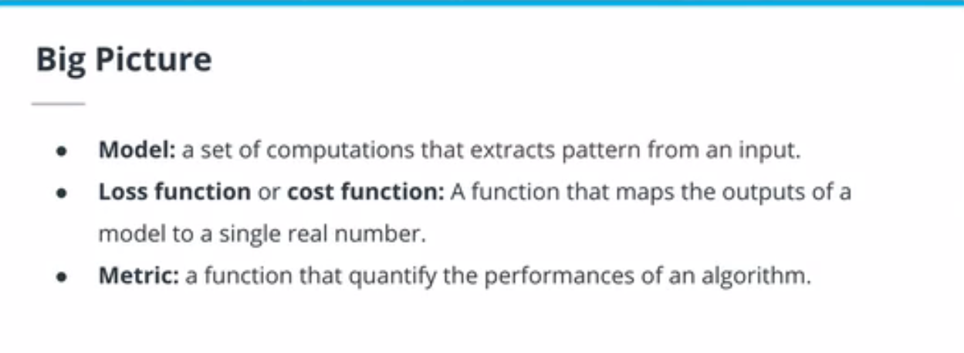
In this course, we will create ML models to predict an output based on an input observation. To estimate the fit of our model, a loss function will be used and the performances of the model created will be quantified with a chosen metric.
Model: a set of computations that extracts pattern from an input.
Loss function / cost function: A function that maps the outputs of a model to a single real number.
Metric: a function that quantifies the performances of an algorithm.

Slide 5
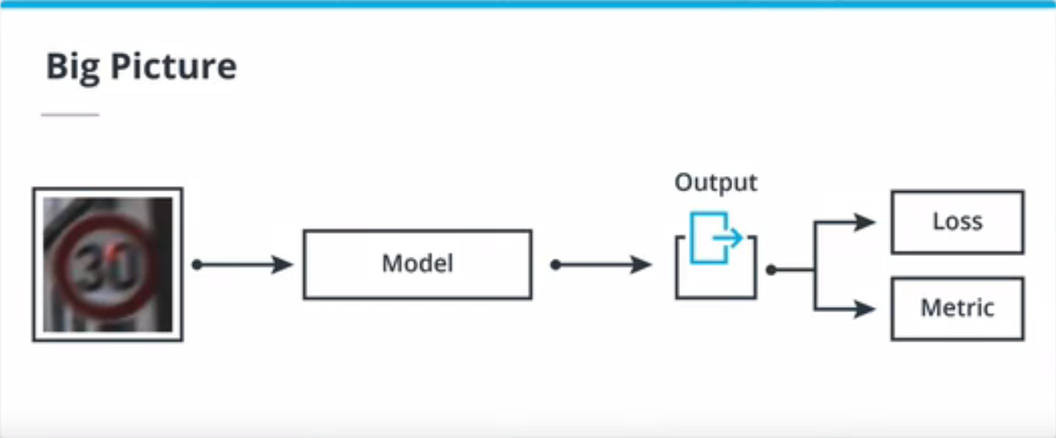
In this course, we will create ML models to predict an output based on an input observation. To estimate the fit of our model, a loss function will be used and the performances of the model created will be quantified with a chosen metric.
Model: a set of computations that extracts pattern from an input.
Loss function / cost function: A function that maps the outputs of a model to a single real number.
Metric: a function that quantifies the performances of an algorithm.

Slide 6
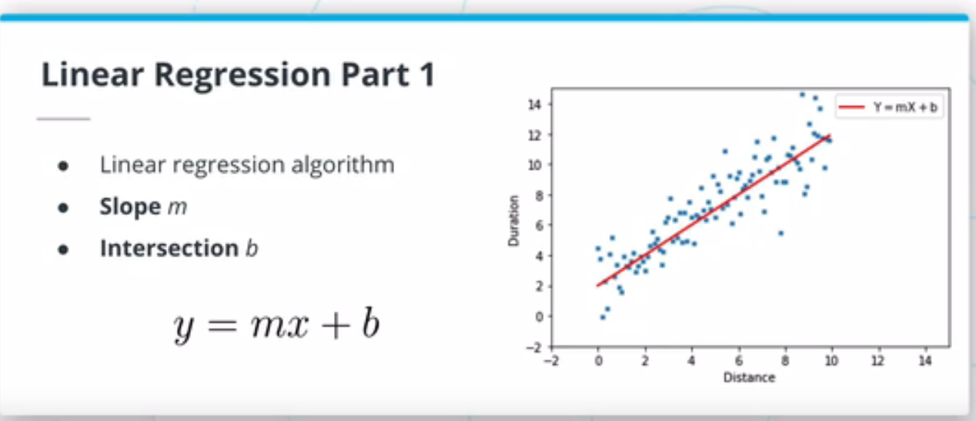
Linear Regression
A linear regression model is a type of ML algorithm that assumes a linear relation between the input variable and the output variable. Such a model is described by two parameters, the slope m and the intersection b such that y = mx +b. Fitting or training such a model requires to adjust m and b to minimize the chosen loss function.

Slide 7
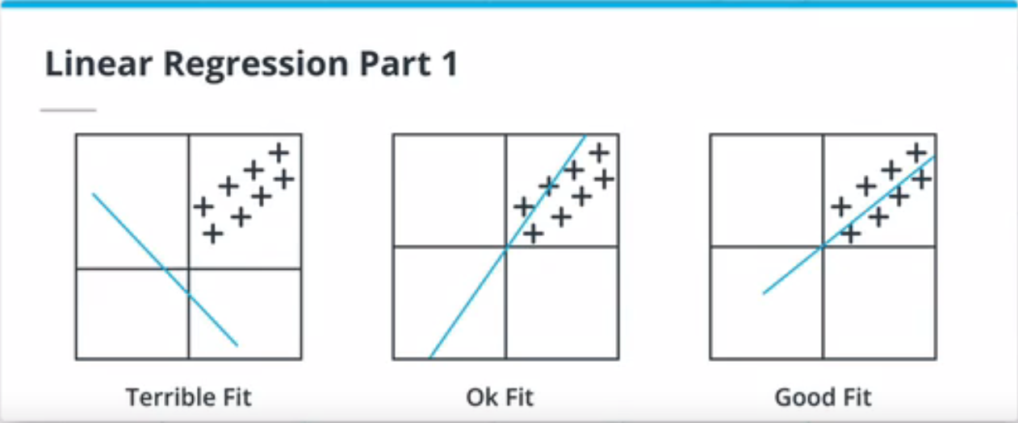
The Mean Squared Error (MSE) loss or L2 loss is the one of the most common function used with linear regression algorithm. It is calculated by summing the square difference of the ground truths and the predictions. Because of the nature of the square function, this loss is very sensitive to outliers (out of distributions data points). If your dataset contains many outliers, the L1 loss (absolute difference between ground truth and predictions) may be a better candidate.

Slide 8
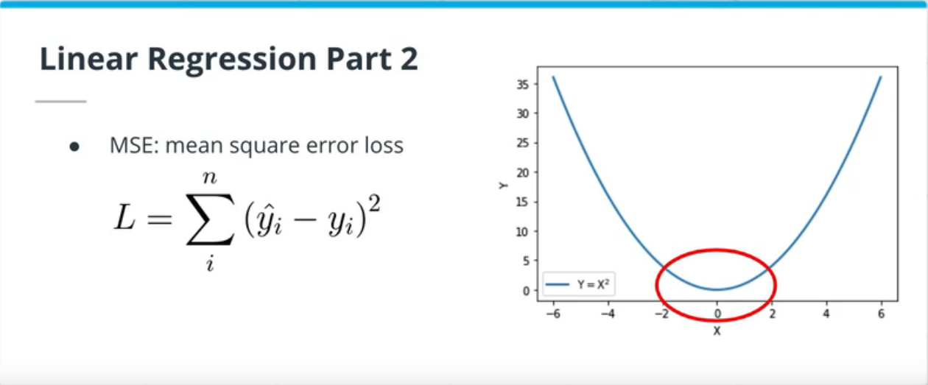
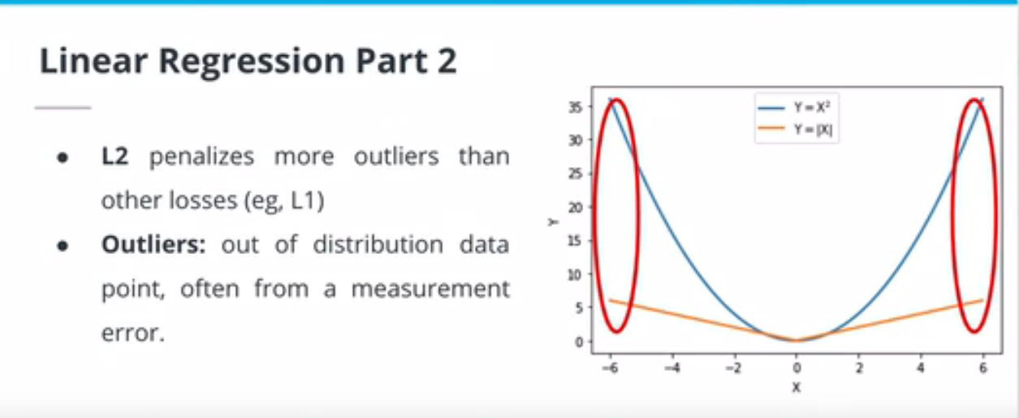

Slide 9
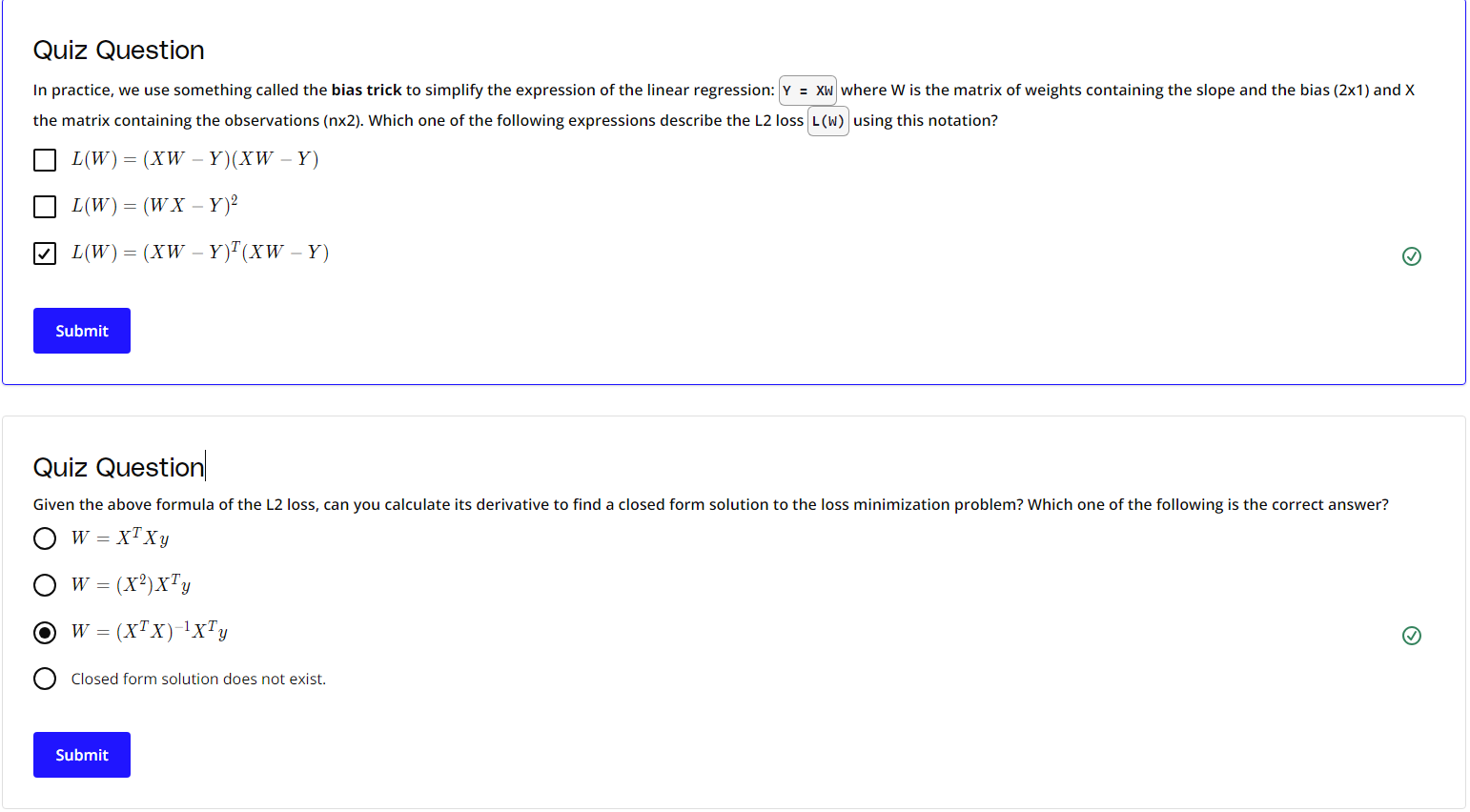

Slide 10
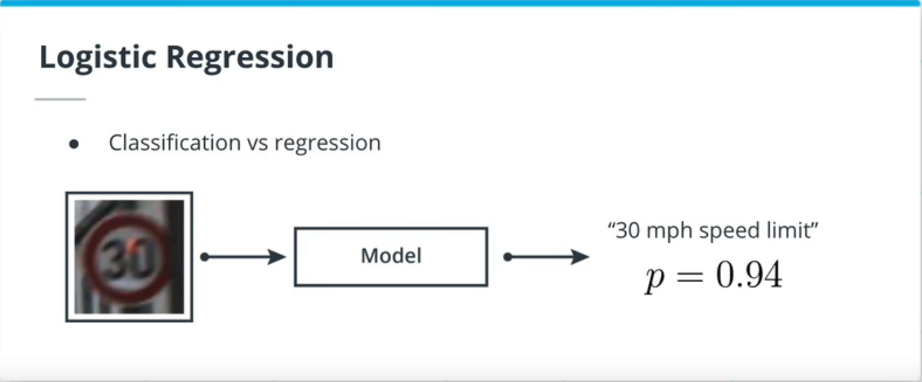
Logistic Regression
For classification problems, we can also use a linear expression to model the probability P(Y|X) of an input belonging to a certain category. Such a model is called logistic regression and looks like this: P(Y|X) = mx+b. However, given that we want to model a probability, we need a way to constrain mx+b to the [0, 1] interval. To do so, we are going to use the logistic function (or sigmoid). The logistic function maps any real number to the [0, 1] interval.
The softmax function is the extension of the logistic function to multiple classes and takes a vector as input instead of a real number. The softmax function outputs a discrete probability distribution: a vector of similar dimensions to the input but with all its components summing up to 1. Later in this lesson, we will describe the sigmoid and softmax functions as activation functions.

Slide 11
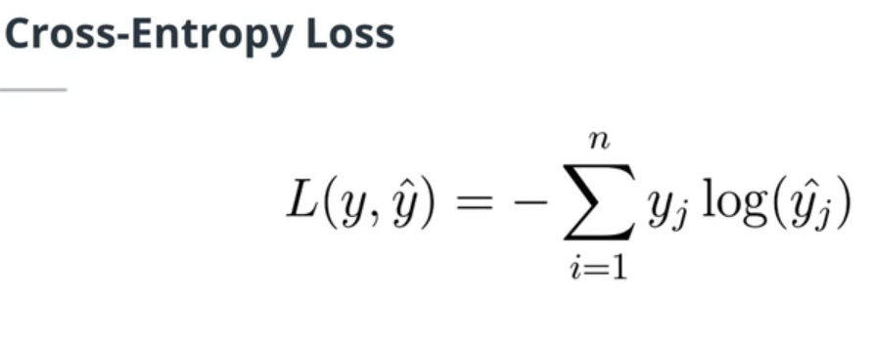
Cross-Entropy Loss and One-Hot Encoding
The Cross Entropy (CE) loss is the most common loss for classification problems. The total loss is equal to the sum over all the observations of the dot product of the ground truth one-hot encoded vector and the log of the softmax probability vector.
For multiple classes classification problems, the ground truth labels need to be encoded as vectors to calculate. A common approach is the one-hot encoding method, where each label of the dataset is assigned an integer. This integer is used as the index of the only non zero element of the one-hot vector.
Summary: for classification problems, the labels need to be encoded to a vector of dimension C, where C is the number of classes in the dataset. Thanks to the softmax function, the model outputs a discrete probability distribution vector, also of dimension.

Slide 12
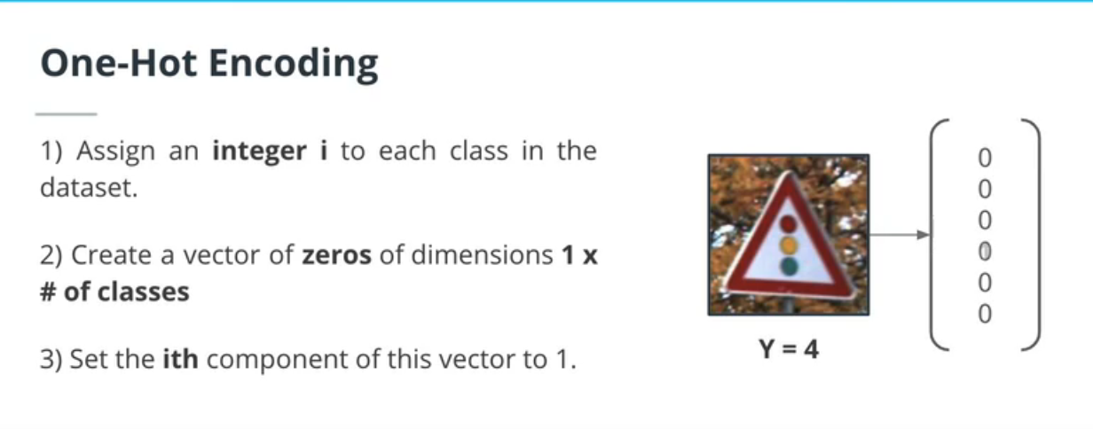
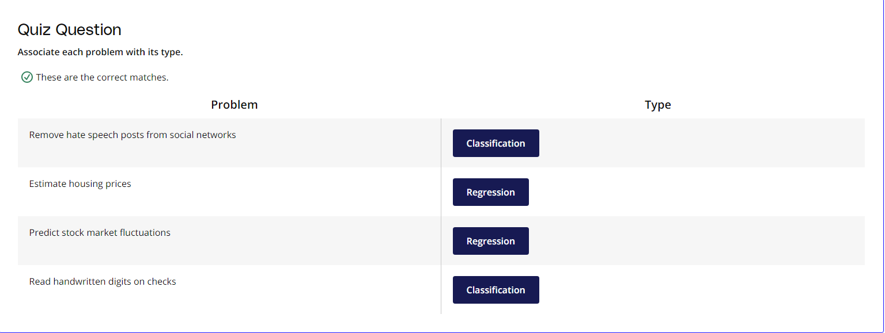

Slide 13
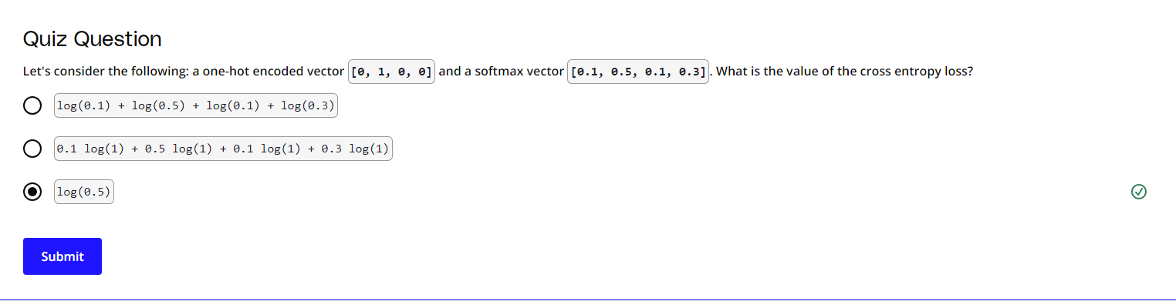

Slide 14
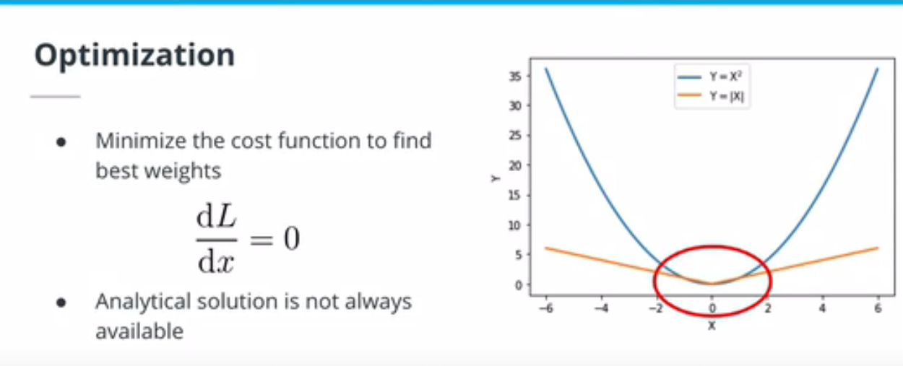
Gradient Descent
Fitting or training a ML algorithm consists of finding the combination of weights that minimizes the loss function. In some cases, it is possible to find an analytical solution (for example, linear regression with L2 loss(opens in a new tab)). However, for most of the algorithms tackled in this course, the analytical solution to the loss minimization problem does not exist.
The gradient descent algorithm is an iterative approach to find the minimum of the loss function. This algorithm takes a step towards this minimum using the gradient of the loss function scaled by a float called the learning rate.
One of the challenges when using the gradient descent algorithm is the existence of local minima. Local minima are minima in a local subset of the loss function domain. They are the smallest value this function can take, only in this small subset, as opposed to the global minimum where the loss function takes the smallest value of its entire domain. The gradient descent algorithm can get stuck in local minima and outputs suboptimal solutions. Later in this lesson, we will see how other approaches solve this problem.

Slide 15

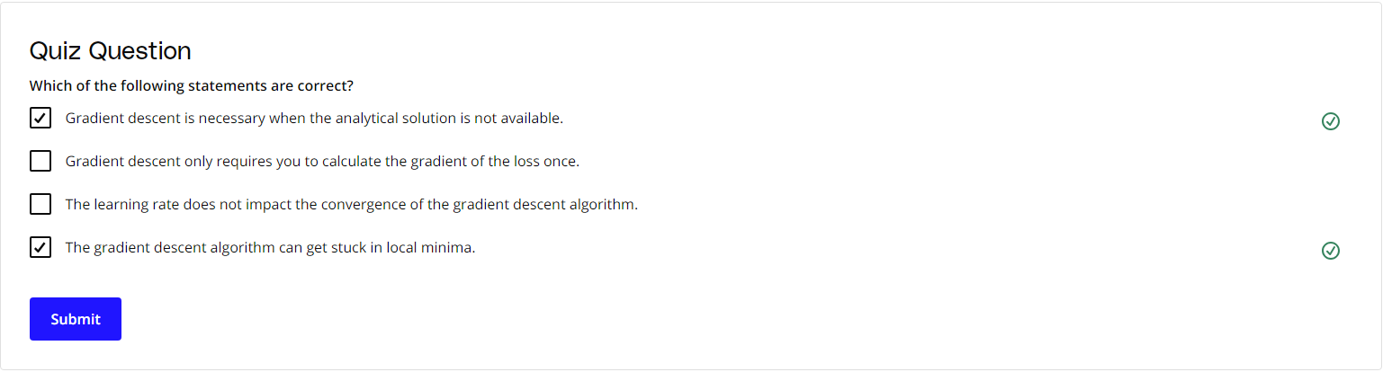

Slide 16
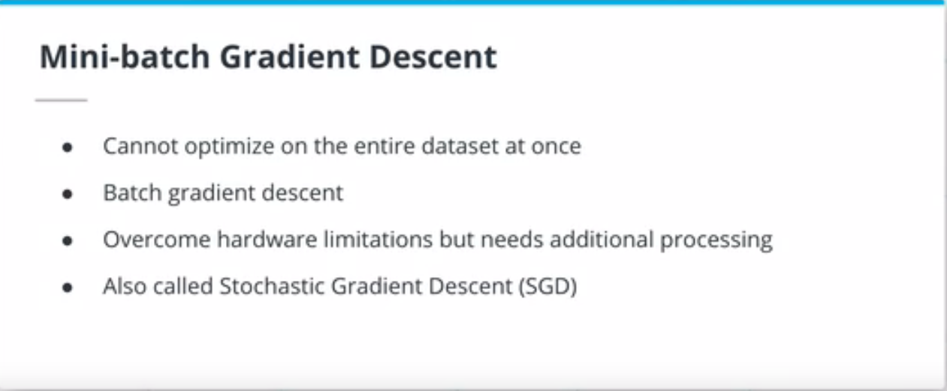
Stochastic Gradient Descent
Because of memory limitations, the entire dataset is almost never loaded at once and fed through the model, as is the case in batch gradient descent. Instead, batches of inputs are created. Gradient descent performed on batches of just one input at a time is called stochastic gradient descent (SGD), while batches of more than one, but not all at once (e.g. 20 batches of 200 images each), are called mini-batch gradient descent.

Slide 17
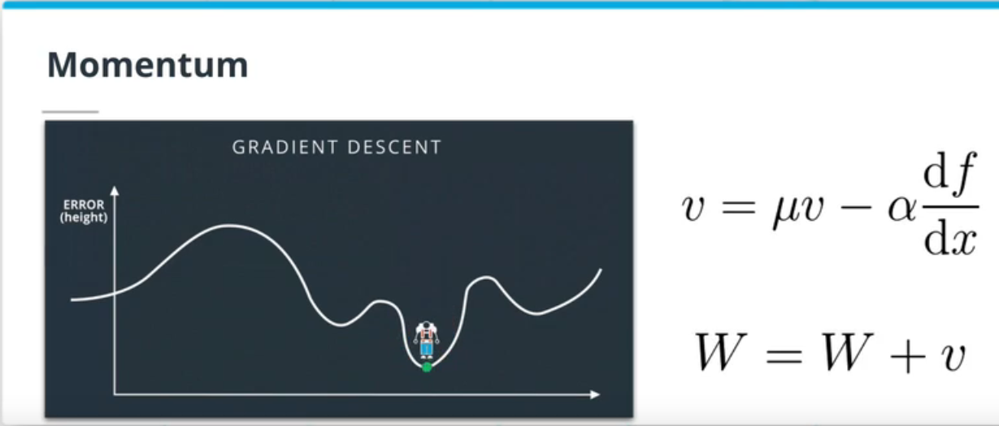
Other Optimizers
One way to overcome the local minima issue is to add a momentum term. This approach is taking its inspiration from physics: the optimizer should gain velocity when taking multiple consecutive steps in the same direction. This velocity will help the optimizer to overcome local minima.
You can read more about momentum in the original paper(opens in a new tab).
This paper provides a nice overview of the most common optimizers used in deep learning: An overview of gradient descent optimization algorithms(opens in a new tab).

Slide 18
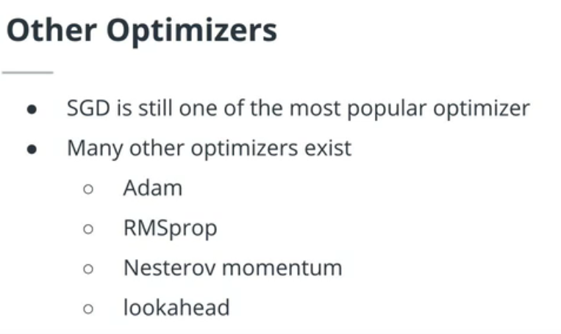

Slide 19
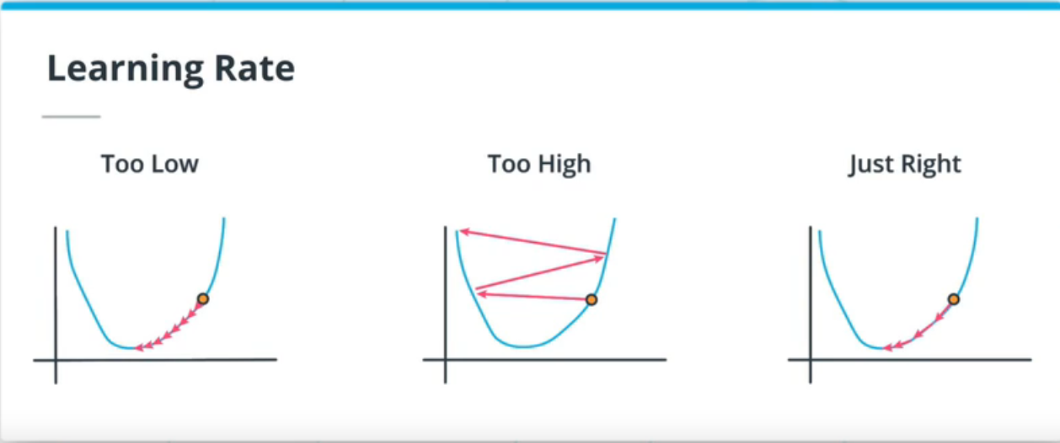
Learning Rates and Annealing
As you will realize in the final project, the learning rate plays a critical role in the success of gradient descent approaches. A very popular approach to improve the performances of gradient descent methods is learning rate annealing which consists of decreasing the learning rate during training. Different strategies exist, such as stepwise annealing, cosine annealing or exponential annealing. The term learning scheduler is also used.

Slide 20
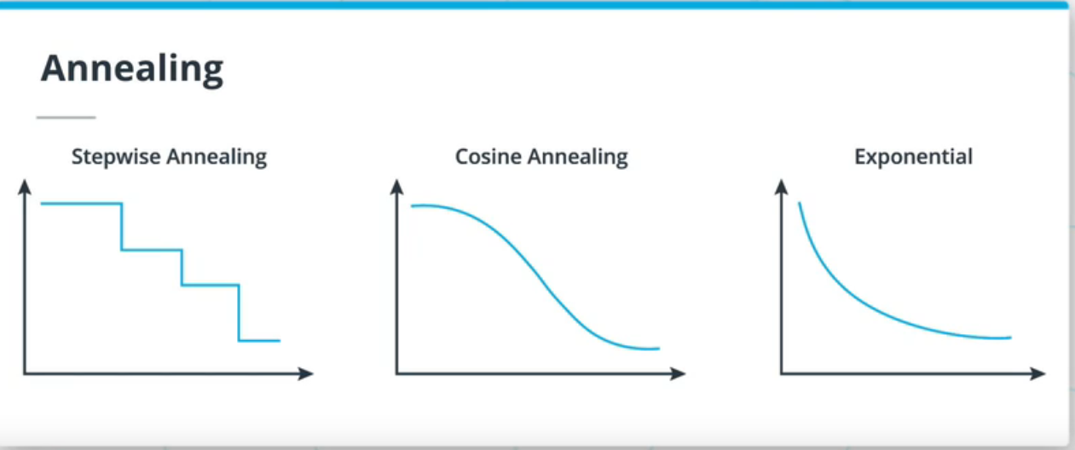
Annealing
While training ML models, we can use fixed learning rates. At the beginning of the training, we can use a high learning rate to make the model converge faster. However after some time, we will need a smaller learning rate to perform finer updates and find the global optimum. Reducing the learning rate during training is called annealing.

Slide 21


Slide 22
Neural Networks
Feed Forward neural networks (FFNN) are an extension of the logistic regression algorithm. We can think of logistic regression as a FFNN with a single layer. FFNN are stacking multiple hidden layers (any layers that's not the input or output layer) followed by non linear activation, such as the sigmoid or softmax activations.
FFNN are only made of fully connected layers, where each neuron in one layer is connected to all the neurons in the previous layer.
Let's consider a neuron in a layer of a FFNN, containing n neurons. The previous layer has m neurons.
This neuron performs a linear operation wX+b using the outputs of the previous layer, meaning that X is a mx1 vector. Instead of looping through each one of the n neurons, we can use a matrix multiplication to perform all the operations at once. The output of this layer will be obtained by calculating WX+B where B is the nx1 vector of biases and W is the nxm matrix of weights.
To simplify even further, we can incorporate the bias vector B in the matrix W such that W is now of dimensions nx(m+1). We simply need to create a new input vector X of dimensions (m+1)x1, where X[m+1]=1 to get the same result as above.

Slide 23
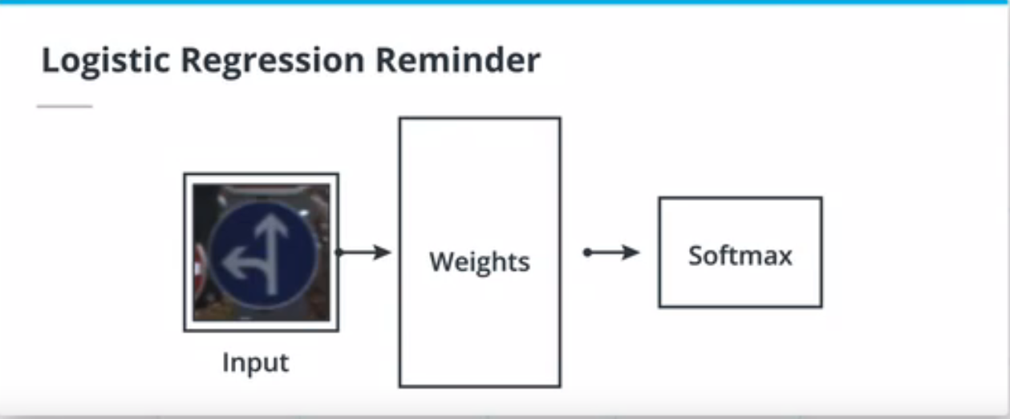
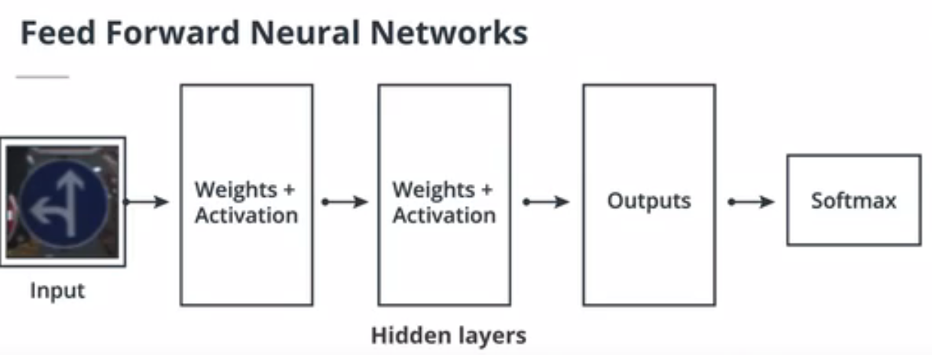
Logistic regression is limited by linearity and number of parameters. Logistic regression may be sufficient for lot of ML problems, but some datasets require parameters with more models simply because of the complexity.

Slide 24
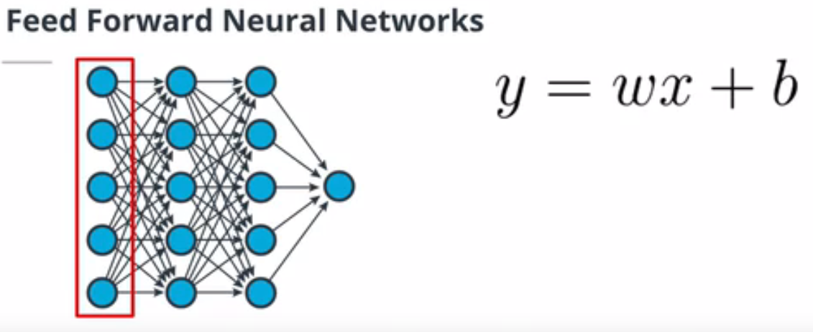
A network made of linear layers and activations only is called feed forward neural network.
The layer has 5 neurons, what that means is X is a vector of 5 elements. The coefficient W of weights which is also a vector of 5 elements. And the bias will be a vector of 1 element. We can repeat this operation for each of the 5 neurons in the second layer. So in total, we will have 25 weights and 5 biases for this layer. We can write this as a matrix operation.

Slide 25
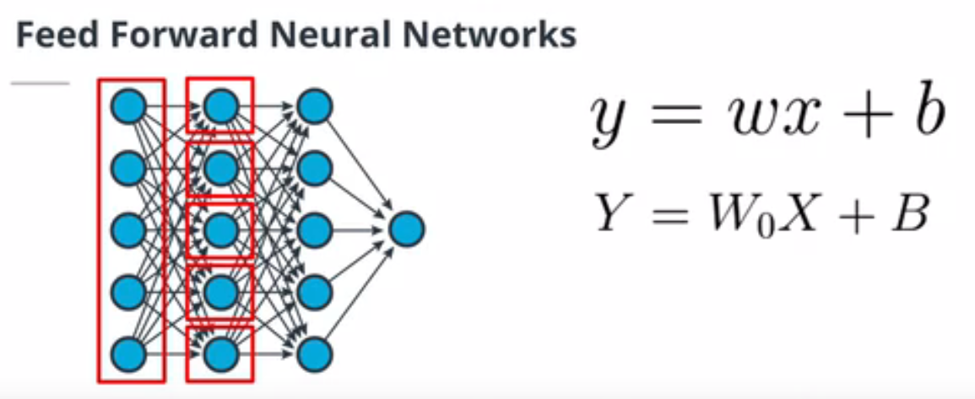
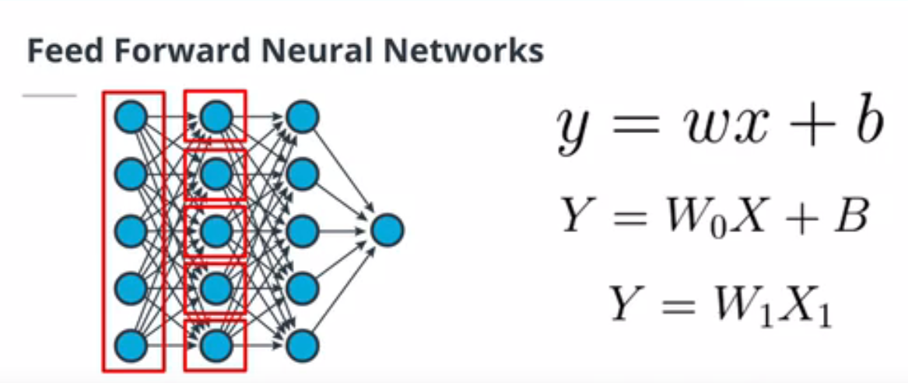
Here X is vector of outputs of first layer, B is a vector of biases and W0 is matrix of weights. Both X and B are vectors of 5 elements and W0 is a matrix of dimension 5*5 because we have 5 neurons in the first layer and 5 neuron in the second layer. We can use the bias trick to simplify this calculation. We can add one element to bias vector X =1 and we can merge the bias parameter in the w matrix. Now x is a vector of 6 elements and w is a 5*6 matrix.

Slide 26
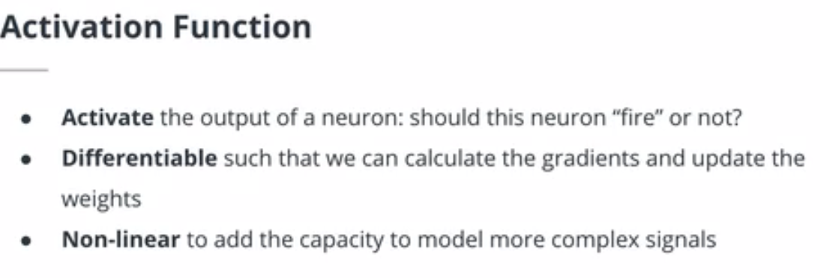
Activation Functions
Activation function takes the output of a neuron and decide if it is going to fire or not. If this feature is calculating a feature that is relevant to our classification problem, it should fire otherwise it should not. This firing or activation depends on the activation function that we use. Because we will be using an algorithm like gradient descent to update the weighst of the neural network we want the activation function to be differentiable.

Slide 27
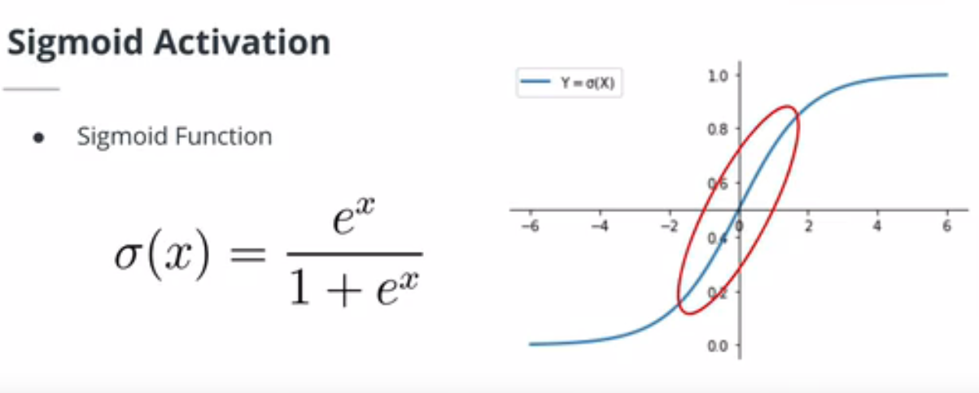
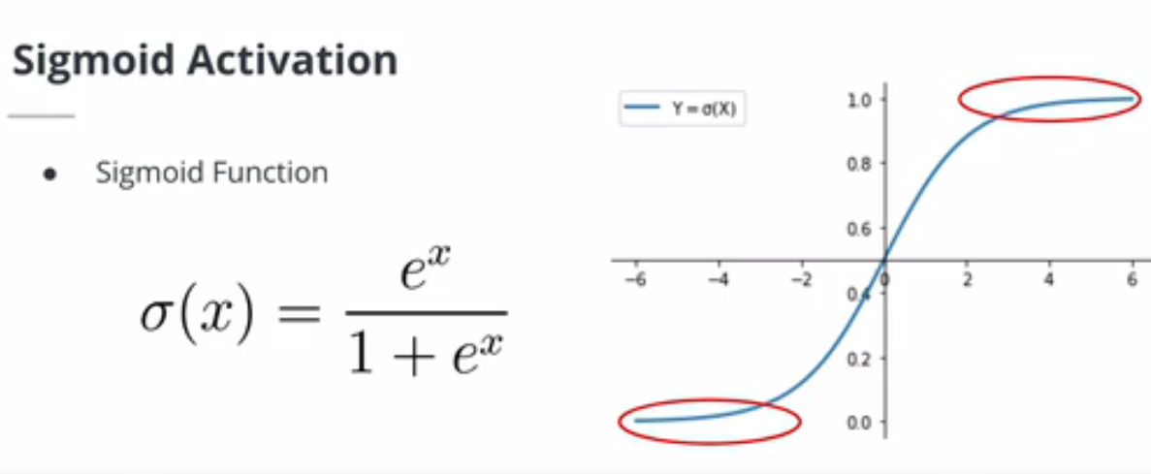

Slide 28
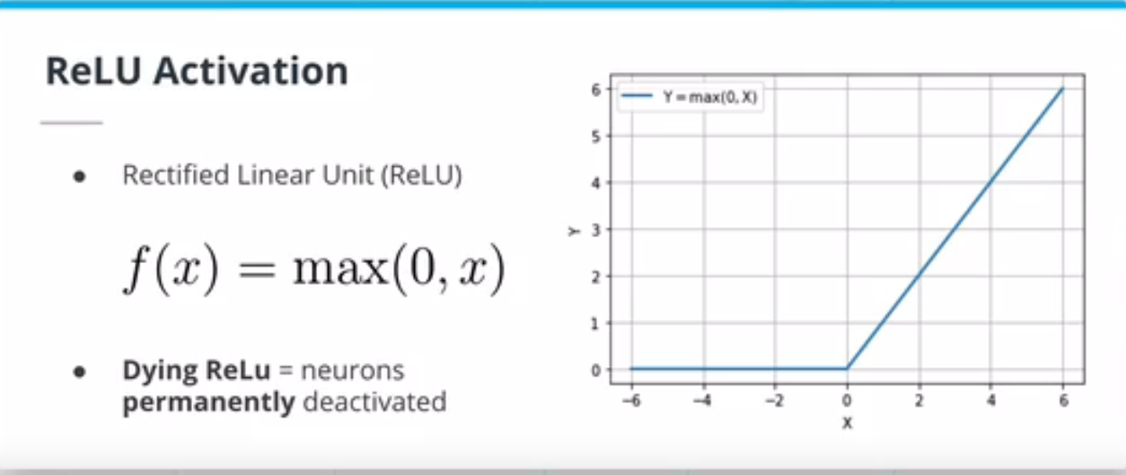
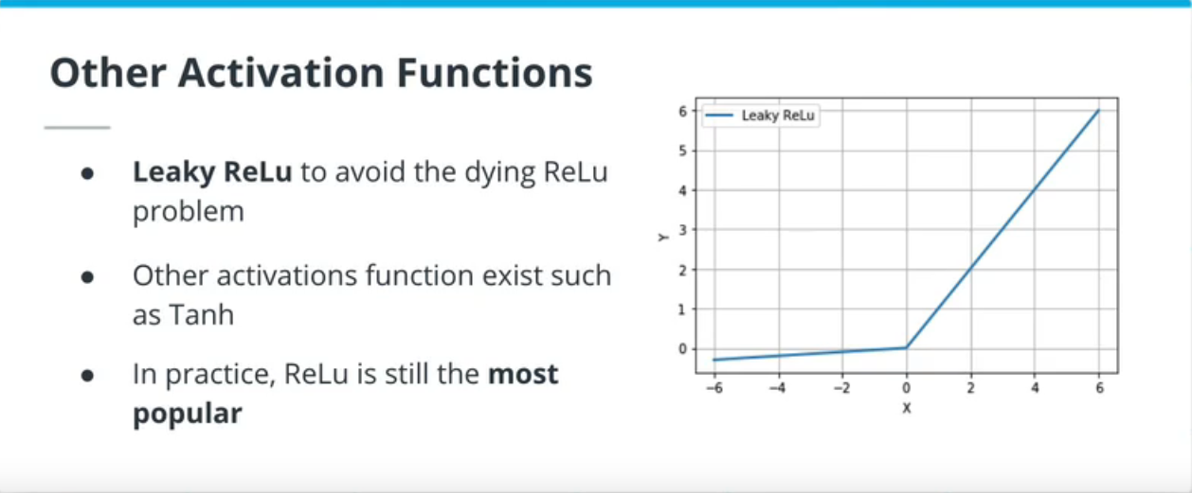

Slide 29
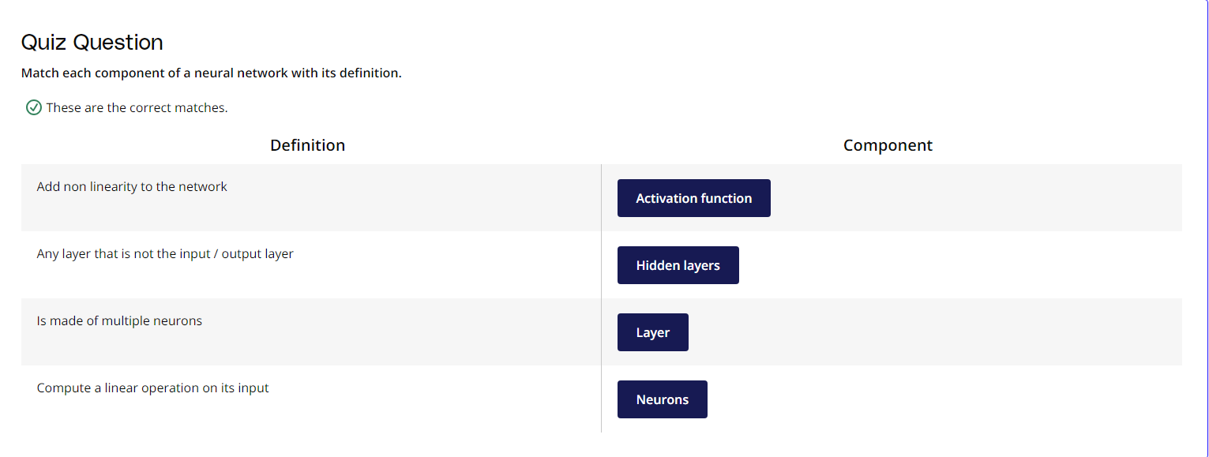
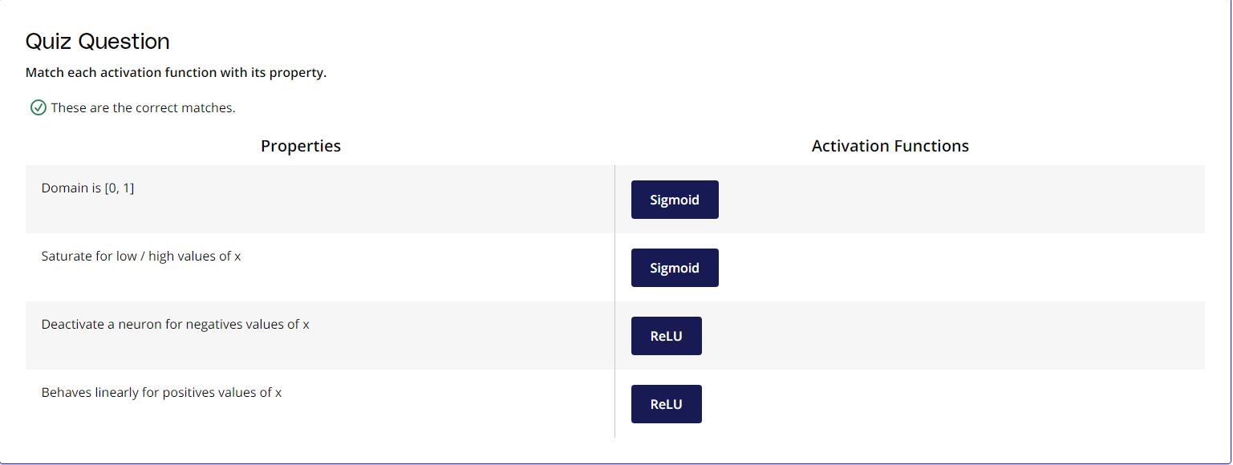

Slide 30
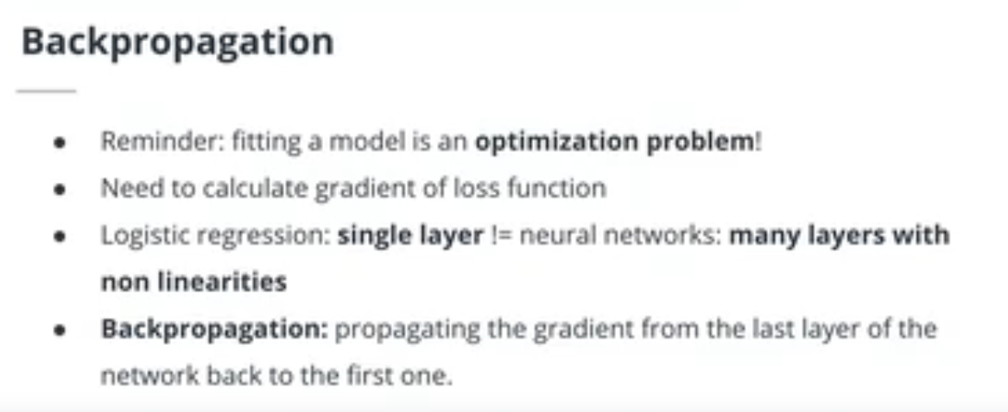
Backpropagation
The chain rule allows you to decompose the calculation of the derivative of a composite function. Because we can think of an ANN as a giant composite function, the chain rule is at the core of the backpropagation algorithm. Backpropagation is the mechanism used to calculate the gradient of the loss with respect to each weight of the neural network.

Slide 31
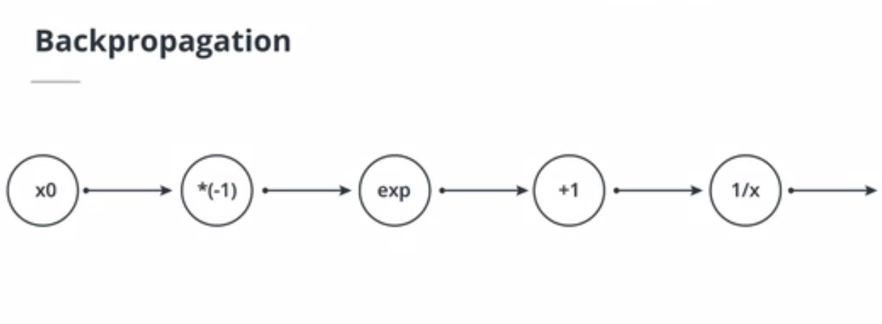
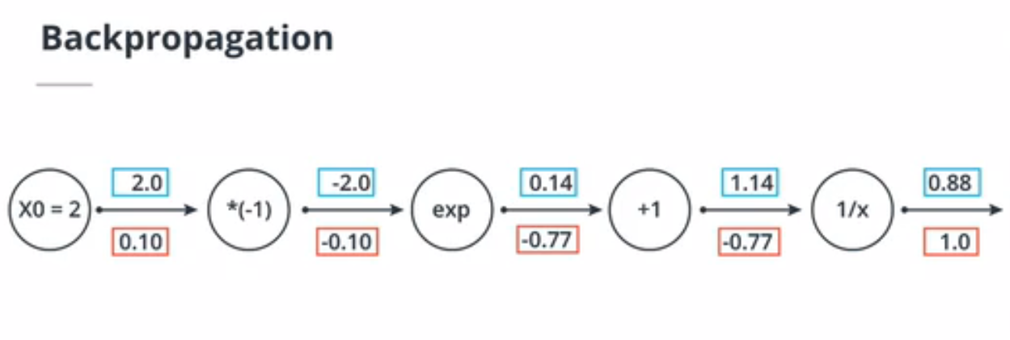
An Example Backpropagation Calculation
The circuit approach is an intuitive way to understand the backpropagation algorithm. Using the chain rule, we can backprogate the gradient from the last node to the first.
For example, the input to the third node is -2 and this node applies the exponential function to its input. The output of this node is exp(-2) = 0.14. When backpropagating the gradient, we get a value of -0.77 before this node. Thanks to the chain rule, and because the derivative of the exponential function is the exponential function, we can backpropagate the gradient as follow: exp(-2) * (-0.77) = -0.10.

Slide 32
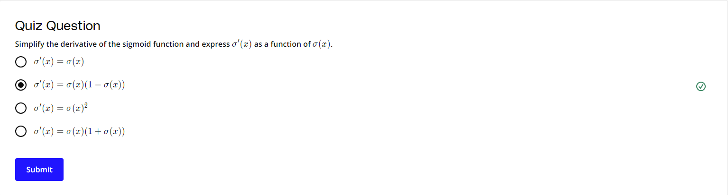
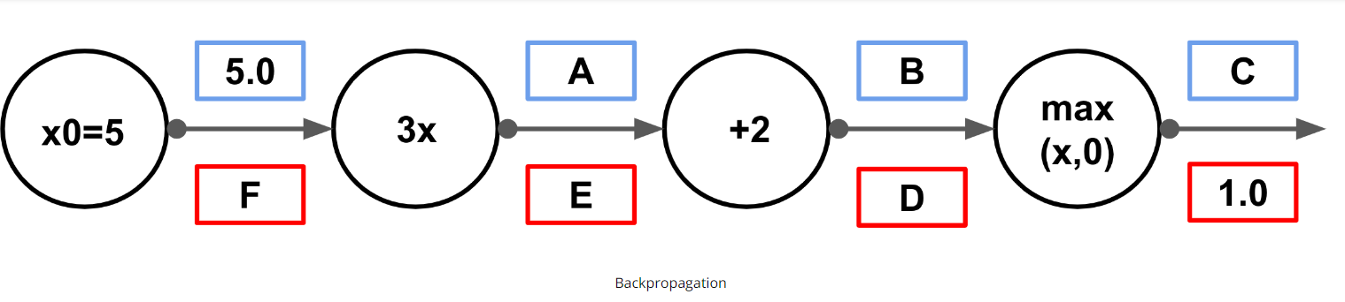

Slide 33
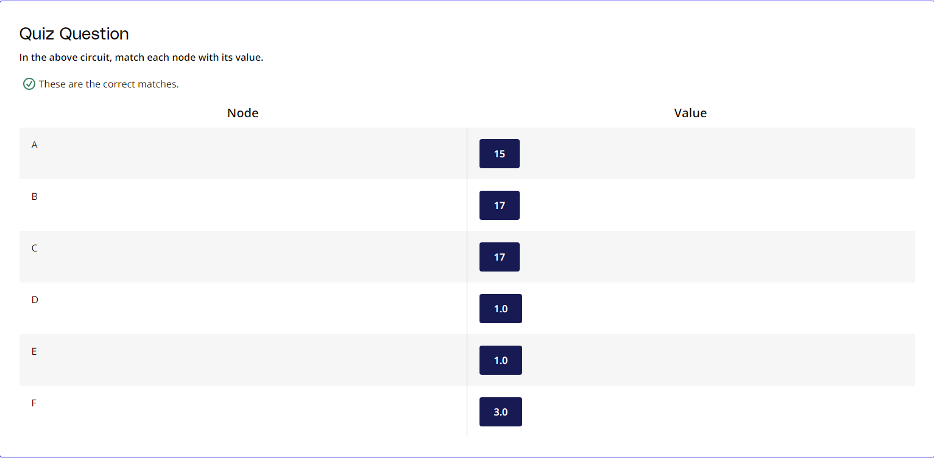

Slide 34
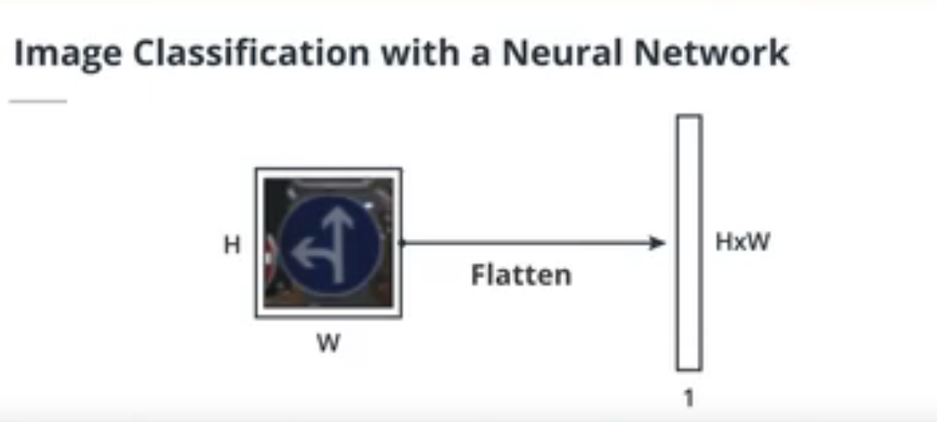
Image Classification with a Feedforward Neural Network
Because feed forward neural networks take vectors as inputs, we need to flatten the HxWxC image to a (HxWxC)x1 vector.

Slide 35
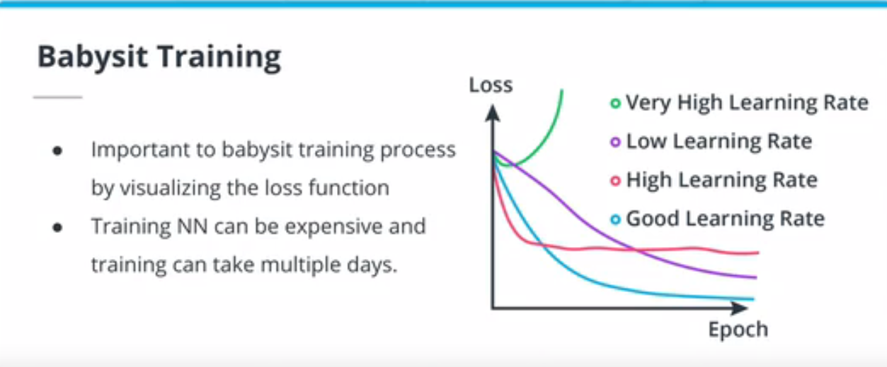
Babysit Training
Training neural networks is a costly and lengthy process. Because so much can go wrong when training a NN, it is critical for the ML engineer to babysit the training process. Visualizing the loss and the metrics will help identify any problems with the training process and allow for the engineer to stop, fix and restart the training.

Slide 36
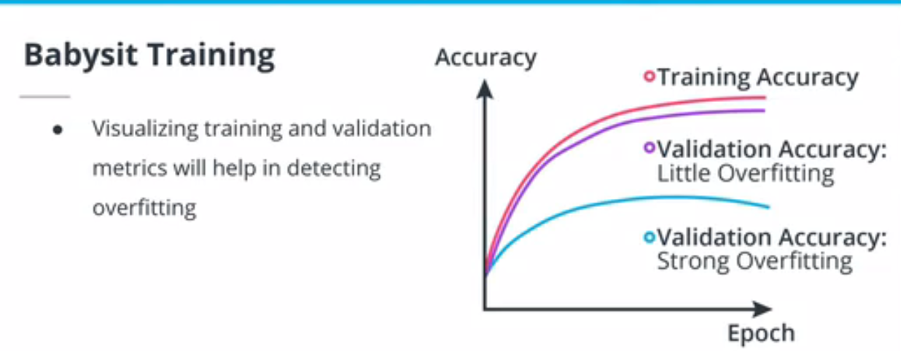

Slide 37
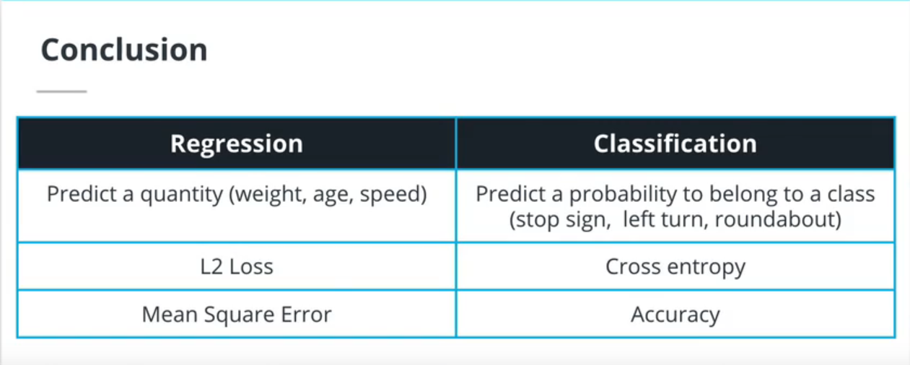
In this lesson, we learned about:
Linear regression: a regression approach to model a linear relationship between two variables. We also discovered the L1 and L2 losses.
Logistic regression: a classification algorithm and a classification loss, the Cross Entropy Loss.
Optimization with gradient descent: an iterative algorithm to find the optimal solution of the loss minimization problem.
Feed forward neural networks: a type of neural network made exclusively of fully connected layers.
Backpropagation: an algorithm using the chain rule to calculate the gradient of the loss in a neural network.
Image classification with a neural network: how to flatten an image to feed it in a feedforward NN.

Slide 38
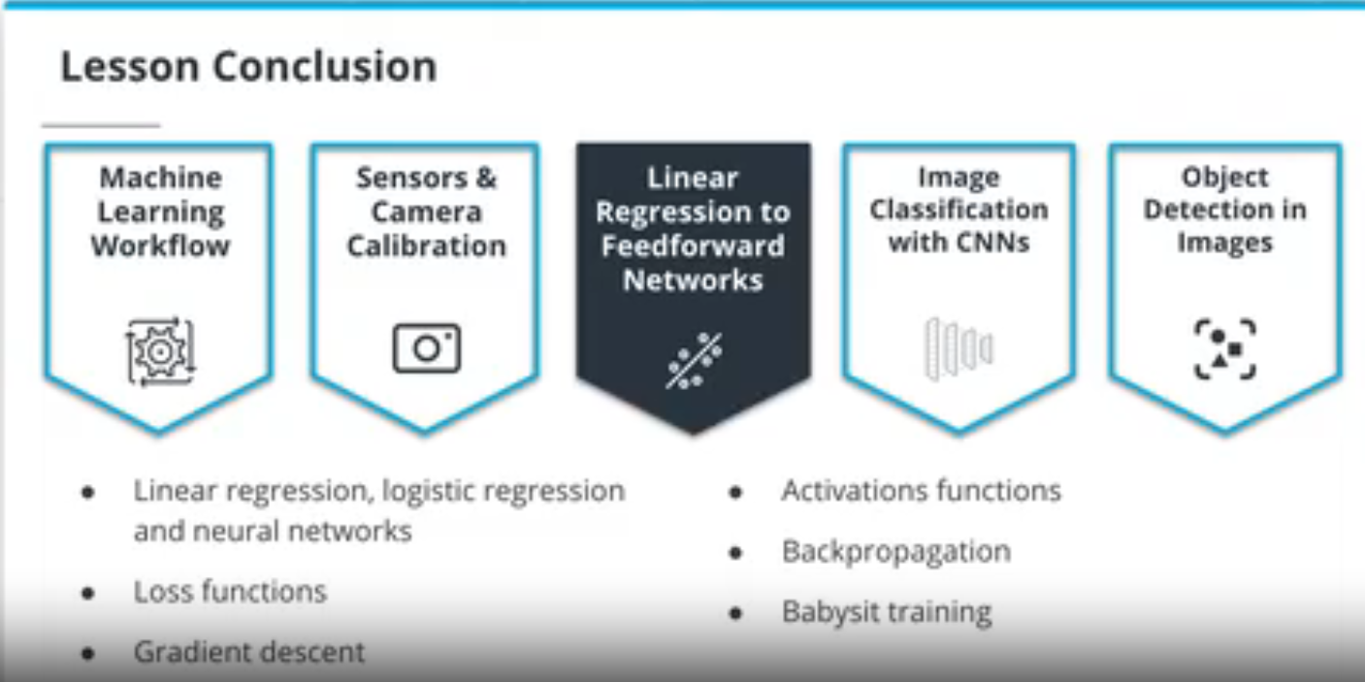

Slide 39
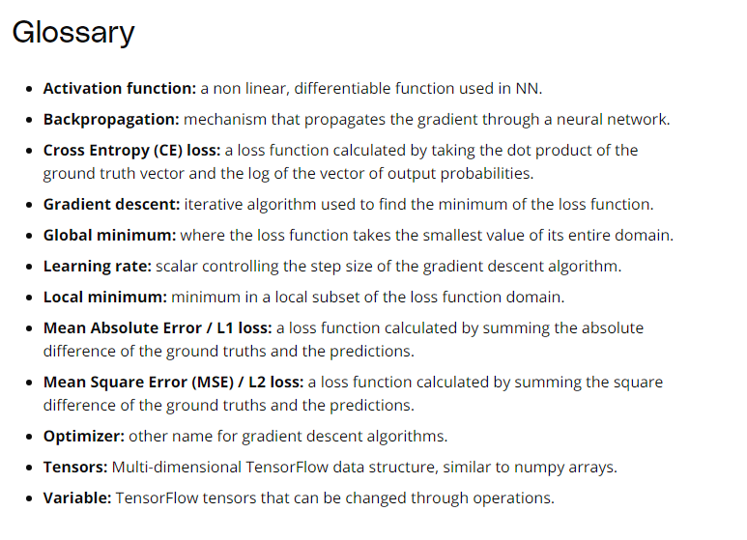

Slide 40
THE END

